Slide 1
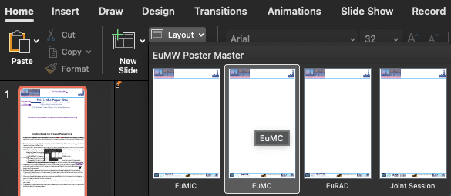
This is the Paper Title
Your logos can go here
(and remove this text box ☺)
Underline name of presenter!
(and remove this text box ☺)
J. Clerk Maxwell^{1,#1}, Michael Faraday^{2,#2}, André M. Ampère^{3,#1,#2}
^{#1}RFIC Lab, My University, Netherlands
^{#2}Microwave Research, Australia
{¹J.Clerk.Maxwell, ³Ampere}@my-uni.edu, ²michael@mr.com.au
Use all of this empty space to create your poster! (and remove this text box ☺)
Instructions for Poster Presenters
All posters will be displayed in portrait mode (vertical) with 1080px x 1920px resolution on a large LCD screen to engage in direct discussions with small groups of interested viewers. This template already has the proper sizing; you’ll only need to fill its contents. Select the proper layout depending on your conference via the ‘Home->Layout’ option list. Use the ‘Joint Session’ layout if your poster session is a joint EuMIC/EuMC or EuMC/EuRAD session.
To ensure a consistent poster look, do not modify the header and footer logos. You can use the empty space in the header to add your own logos. Please do not modify the paper title/author format and font selection, just replace the text to represent your paper and (co)authors.
Make sure all fonts are embedded to avoid display problems, e.g. using “PDF-A” compatibility when exporting as pdf.
You are not allowed to attach your own laptop or insert your own USB-stick into the displays of the poster session, as the screens are controlled remotely at least part of the time.
Poster tips:
  Avoid large pieces of text, certainly don’t copy pages of your paper.
  To ease readability, don’t use text smaller than 15mm (preferably 20mm!) on the scale of this template
  A clear introduction, conclusion, the use of color graphics, and headline-style phrases in bullet points allows the audience to quickly grasp the intended message.
Please follow the upload instructions in the email. Should you have an update, follow the submission instructions in the email.
A single static slide, independent from the poster, in landscape orientation, is to be used for the poster pitches. There is no specific template associated with this slide; you are completely free to design it as desired. Please follow the instructions in the email, as the pitch-slides will be combined for an efficient rotation during the pitches.
At the EuMW in Utrecht, please contact your poster chairs before your session. Check your poster with them before your session.
It may be helpful to have business cards and paper copies of your written submission available for visitors to take with them to enable future correspondence.
You can remove this textbox and use all this empty space to create your poster
This square is 15x15mm

